Slide 1
UNIT 5:
Fish biology

Slide 2
Population dynamics
Activity 5.1: Students to identify processes that lead to changes in fish populations

Slide 3
Population dynamics
Population dynamics describes how a population changes in size through time (Russell‘s Axiom):
Stock size₁ = Stock size₀ + (recruitment + growth) – (natural mortality + catch)
This is the basis for understanding fishery patterns!

Slide 4
Population dynamics
Recruitment - the number of new young fish that enter a population each year
Growth rate - measured as the gain in weight and/or length throughout their life
Mortality rate - this is made up of fishing mortality and natural mortality

Slide 5
Reproduction
Different reproductive strategies in marine animals:
Activity 5.2: Identify reproductive strategies of some of the local marine animals.

Slide 6
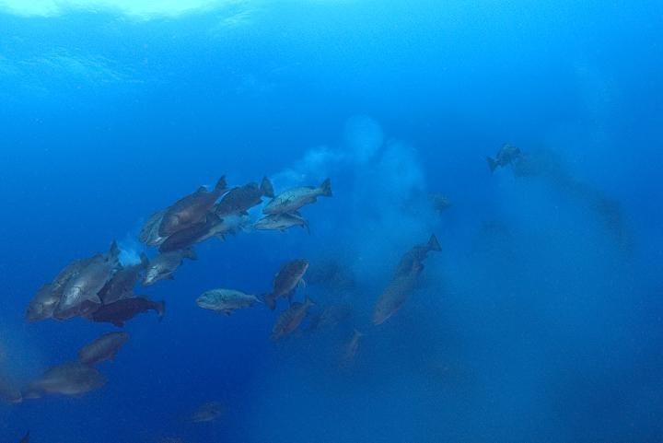
Reproduction
Broadcast spawners
most fish species & some invertebrates (corals, clams, beche de mer)
planktonic larval stage
thousands – millions of larvae
high mortality of larvae that can vary enormously from year to year

Slide 7
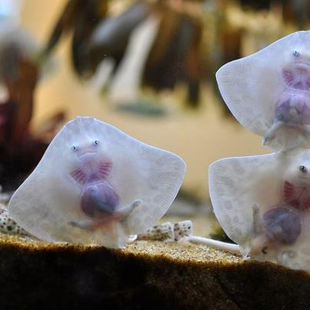
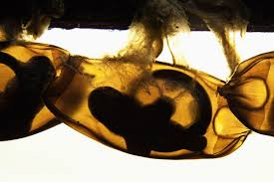
Reproduction
Live young bearers
many sharks species, whales, dugong
relatively few young produced
well developed at birth
low mortality rates of young
Egg-layers
turtles, some fish and some sharks
low number of offspring
mortality during early development can be high

Slide 8
Reproduction
Asexual reproduction
some corals, sponges and beche de mer
fragmentation – where parts of the animal breaks off and regenerates
fission – where the animal splits and the new part regenerates
DVD: Where do fish come from?

Slide 9
Recruitment
Recruitment strongly influences good and bad fishing years.
Success of larval recruitment is linked to a temporal alignment of fish reproducing, other larvae hatching, plankton (prey) abundance, and favourable environmental conditions.
High larval survival = subsequent good fishing years, etc.
Even without fishing, populations would vary a lot.
Fisheries need to maintain good levels of spawning biomass (adults)
Fecundity in fish increases exponentially as fish get larger
Larvae more robust in larger, older fish
Important to have maintain large individuals in the population

Slide 10
Biology
DVD: How to make fish
DVD: SCRFA spawning aggregations
Activity 5.3: What are some of the reasons why animals die?

Slide 11
Mortality
Natural mortality – rate at which populations die off naturally
Disease, predation, or old age
Cannot control natural mortality but we can control:
Fishing mortality – rate at which populations die off due to fishing
Many fisheries management tools are about reducing fishing mortality via:
- effort controls
- catch controls
- temporal/spatial closures
- size and bag limits

Slide 12
Productivity
Productivity represents the capacity for a population to replenish itself and involves several processes:
Recruitment
Growth
Maturation
Longevity
Natural mortality

Slide 13
Productivity
High productivity populations (eg. Sardines) tend to be:
Fast growing
Early maturing
High natural mortality
Short-lived
These populations are able to replenish themselves quickly (1-2 years)
Low productivity populations tend to be the opposite (eg. sea cucumbers)
Replenishing these populations may take many years

Slide 14
Productivity
Activity 5.4: In groups, use the following species list, or create your own list of ~10 local species, and group them from most productive to least productive. Use the following categories:
most productive
moderately productive
least productive.
Each group to present back to the class and explain groupings.
Species: coral trout, sea cucumber, white tip reef shark, grouper, cuttlefish, turtle, snapper, stingray, anchovy, grey reef shark
Notes:
*see course notes for advanced section on sustainable yield

Slide 15
Movement
Activity 5.5: Identify some local species that are resident and some that are transient. Use local names if you like.

Slide 16
Movement
Movement of species is what determines the level of connectivity within an ecosystem.
For each species, information about movement is critical for appropriate management (see example in notes)
Unit stock (Ihssen et al., 1981): an intraspecific group of randomly mating individuals with temporal or spatial integrity.
Knowledge of target species stocks and their structure is viewed as the basis for any fishery analysis, but
need to work within our knowledge base
Notes:
*see course notes for extra activity for advanced students

Slide 17
Movement
Different movement patterns:
Larval drift/movement
Life history stages (eg. inshore --> offshore once mature)
juveniles of many species live inshore (mangroves, seagrass beds, estuaries) & move to reefs once mature. Eg.?
Once settled some species establish territories and don’t move much throughout their life. Eg.?
fine scale habitat changes within reefs (juv. – adult) Eg.?
Pelagics may move their entire life (within stock boundaries) Eg.?
Movements influenced by temperature, prey, spawning, density, maturity, etc.

Slide 18
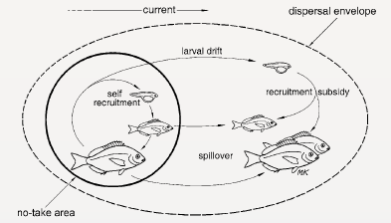
Movement
Importance of movement in a management context

Slide 19
Biology & EAFM
Activity 5.6: Write in your notebooks: What are differences between ecosystems and populations? Write in notebooks: why foodwebs and movement matter to fisheries management. Use the heading “Activity 5.6”.
Most fisheries in the tropics are multi-species
some species will be more vulnerable to fishing that others (different productivities)
To minimise alteration of the ecosystems species assemblage
adopt appropriate management measures for low productivity species AND for high productivity species
develop and monitor ecosystem-based indicators
adopt a precautionary approach

Slide 20
Unit review
Different modes of reproduction
Recruitment of new generations are critical for populations
Controlling mortality rates is the simplest way to help sustain populations
Productivity represents the capacity for a species to replenish its population naturally
Understanding species movements helps to choose appropriate management

Slide 21
Biology
15 minute personal review: unit review, students to review main concepts of unit in the course notes, contribute any new words (new to them) to their own personal glossary in the back of their notebook (local language equivalent terms should also be recorded where possible)

Slide 22
Homework
What are the four population processes that contribute to changes in a population?
What are three different modes of reproduction in animals that live in marine ecosystems? Rank them in order from most productive to least productive in terms of fishing that they could support.

Slide 23
Optional component
Advanced slides

Slide 24
Sustainable yield
Sustainable yield, or catch, is the level of catch that can be taken from a population indefinitely.
The use of Maximum Sustainable Yield (MSY) in fisheries is to try and maximise how much is caught. This has led to many fisheries collapses.
Generally used for single-species management, but the principles are useful for EAFM.

Slide 25
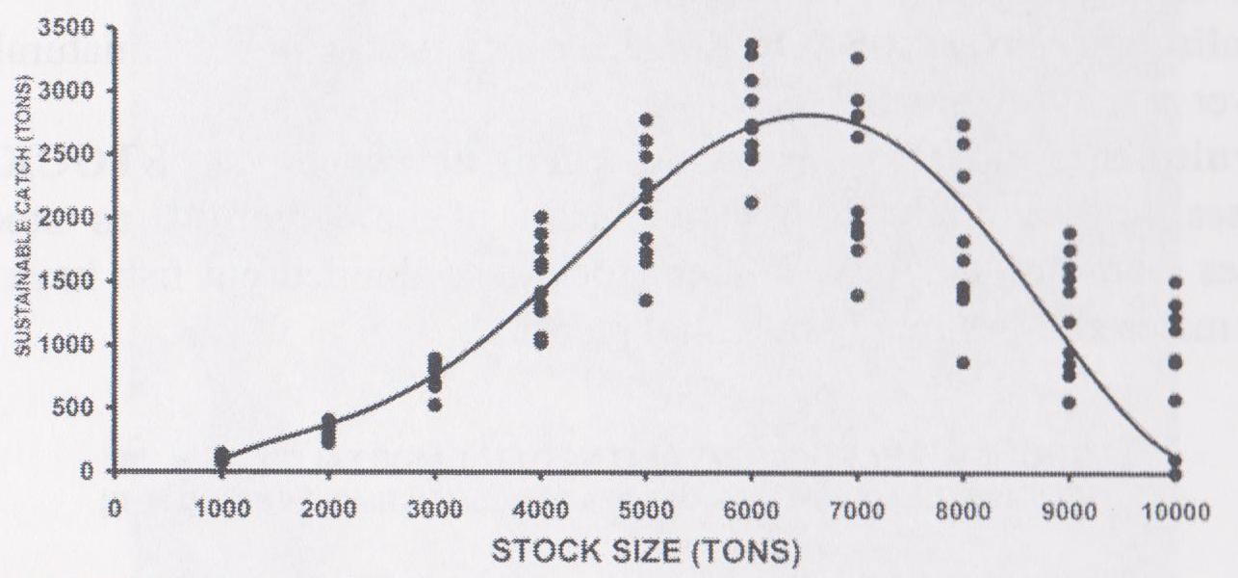
Sustainable yield

